Slide 1

LECTURE 1
M O B I L E A P P PROGRAMMING
DANIEL R YS JAN VÁCL AVÍK

Slide 2
C O U R S E S T R U C T U R E
12 lectures (every Tuesday till 24.5.)
Intro to multi-platform apps
Ionic
Ionic + Electron
Ionic version 2
React Native
6 homeworks (till 16.4.)
Team projects
16.4. – Assignment
28.5. – Presentation
Final test (28.5.)

Slide 3
N AT I V E V S . H Y B R I D A P P S

Slide 4
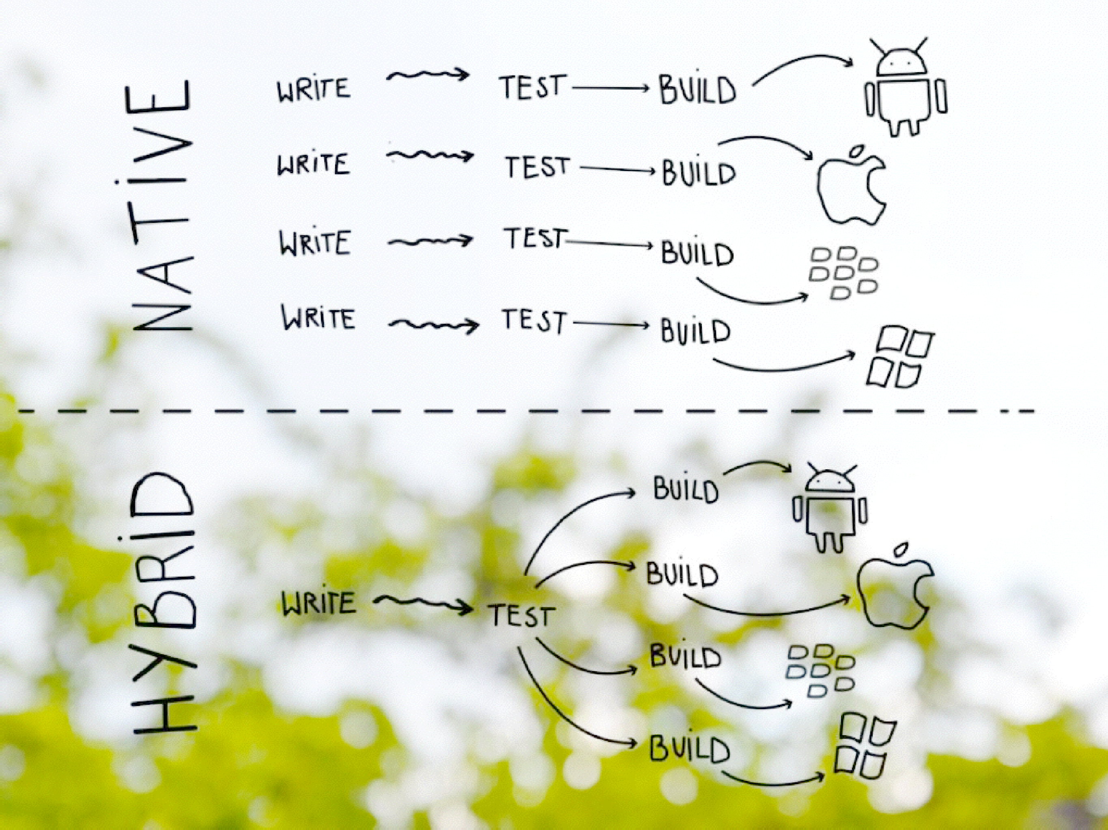
10
/68

Slide 5
N AT I V E
H Y B R I D
+ Good for complex effects
+ Native UI support
+ Better for old devices
+ Multiplatform development
+ Mobile, desktop app, web
+ Easy to debug
+ Web technologies
-
-
Expensive
Multiple codebases, languages
Complicated updates
-
-
Needs better HW No native UI support
-

Slide 6
M O R E P L AT F O R M S , M O R E P R O B L E M S , M O R E L A N G U A G E S
Android – Java
iOS – Objective-C / Swift
Windows (+mobile) – C#
BlackBerry – Qt / C++, Javascript…
Linux – Qt / C++,…
Mac OS X – Objective-C / Swift
Mobile web – Javascript
Arduino – Wiring, C++

Slide 7
I N P E R F E C T W O R L D
Android – Javascript
iOS – Javascript
Windows (+mobile) – Javascript
BlackBerry – Javascript
Linux – Javascript
Mac OS X – Javascript
Mobile web – Javascript
•
Arduino – Javascript

Slide 8
I N P E R F E C T W O R L D
Android – Javascript
iOS – Javascript
Windows (+mobile) – Javascript
BlackBerry – Javascript
Linux – Javascript
Mac OS X – Javascript
Mobile web – Javascript
Arduino – Javascript
Possible
now!
right

Slide 9



W AY S O F M O B I L E D E V E L O P M E N T
Native apps
Compilers
to native code
Hybrid app
Native app + WebView
Mobile web
Progressive mobile apps,…
Java, Swift, C#, …

Slide 10

W AY S O F M O B I L E D E V E L O P M E N T
Native apps
Compilers
to native code
Hybrid app
Native app + WebView
Mobile web
Progressive mobile apps,…
Java, Swift, C#, …
Our main focus

Slide 11
C A S E S T U D Y
Create Android, iOS, WP apps for showing weather data from API *
TYPE | TECHNOLOGIES | TEAM SIZE | MD | PRICE
NATIVE APP | JAVA, SWIFT, C# | 3 | 12 | 24 000 CZK
COMPILED APP | C# | 1 | 8 | 16 000 CZK
HYBRID APP | WEB TECH | 1 | 5 | 10 000 CZK
MOBILE WEB | WEB TECH | 1 | 3 | 6 000 CZK

Slide 12
C O M P I L E R S T O N AT I V E C O D E
Using easier languages than Objective-C/Swift or Java
Compiling to native code afterwards
Has advantages from both (native app, easier to make)

Slide 13
H Y B R I D A P P S
HTML5 app acting like native
Web wrapped in native layer
Develop a single code base (web platform)
Direct access to native APIs
Familiar web dev environment

Slide 14

Our biggest mistake was betting too much on HTML5
Mark Zuckerberg
Founder of Facebook

Slide 15
ASK YOURSELF
Our biggest mistake
was betting too much on HTML5
Mark Zuckerberg
Founder of Facebook
21/68
1. Have a multi-million dollar budget?

Slide 16
ASK YOURSELF
Our biggest mistake
was betting too much on HTML5
Mark Zuckerberg
Founder of Facebook
22/68
Have a multi-million dollar budget?
Have a large team of experienced native developers?

Slide 17
ASK YOURSELF
Our biggest mistake
was betting too much on HTML5
Mark Zuckerberg
Founder of Facebook
23/68
Have a multi-million dollar budget?
Have a large team of experienced native developers?
Does your billion-dollar revenue depend on this app?

Slide 18
ASK YOURSELF
Our biggest mistake
was betting too much on HTML5
Mark Zuckerberg
Founder of Facebook
24/68
Have a multi-million dollar budget?
Have a large team of experienced native developers?
Does your billion-dollar revenue depend on this app?
If so… Do native

Slide 19
OTHERWISE GO HYBRID
25/68

Slide 20

Hybrid apps are slow!
20
/68

Slide 21


Hybrid apps are slow!
YOU ARE SLOW!
21
/68

Slide 22
Hybrid apps are slow!
Hybrid apps
are slow!
PEOPLE HAVE BEEN SAYING THAT SINCE 2010
22
/68

Slide 23
M O B I L E D E V I C E S H AV E R A P I D LY I M P R O V E D
YEAR | DEVICE | PROCESSOR | RAM
2007 | IPHONE | 620 MHz | 128 MB
2010 | IPHONE 4 | 1 GHz | 512 MB
2015 | IPHONE 6 | 1.4 GHz DUAL-CORE | 1 GB

Slide 24
M O B I L E D E V I C E S H AV E R A P I D LY I M P R O V E D
YEAR | DEVICE | PROCESSOR | RAM
2017 | IPHONE 8 | 2 x 2.1 GHz + 4 x 2.1 GHz | 2 GB
2018 | IPHONE X | 6 x 2.39 GHz | 3 GB
2019 | IPHONE XR | 2 x 2.5 GHz + 4 x 1.6 GHz | 3 GB

Slide 25
W E B - B R O W S E R S H AV E R A P I D LY I M P R O V E D
Android is now Chromium-based
Better performance, faster rendering on Android / iOS
New features: Gestures, transitions, transforms, scrolling, SVG, CSS 3, input types, File API, Web sockets API, Beacon API, Vibrations API, audio / video formats, Web Audio API, Form validation, Security, etc.

Slide 26
P L U G I N S

Slide 27
3D touch, SMS, Geolocation, SQLite Storage, Devic Motion, Action Sheet, Audio, Video, Contacts, Whitelis Ionic Keyboard, File Transfer, File API, Clipboard Camera, Barcode scanner, InApp Browser, Splash Screen Touch ID, In-App purchases, iBeacon, Calendar, Networ nformation, Screen orientation, AdMob, Native pag transitions, Image picker, Local notifications, File opene Modal, Dialog, Confirm, Alert, Date picker, Status ba Video thumbnail, Push notifications, Background service Social sharing, Vibration, Fullscreen, Crop, Console Battery status, Live reload, Google Analytics, Crosswalk Mobile accessbility, Media playback, Toast messaging Google maps, Hockey app, Panorama viewer, Bluetooth Carnival, NFC, Brightness, OAuth, Music, Apple Wa³²t^{/6}c⁸h

Slide 28
3D touch, SMS, Geolocation, SQLite Storage, Devic Motion, Action Sheet, Audio, Video, Contacts, Whitelis Ionic Keyboard, File Transfer, File API, Clipboard Camera, Barcode scanner, InApp Browser, Splash Screen
Touch ID, In-App purchases, iBeacon, Calendar, Networ
M A N Y
nformation, Screen orientation, AdMob, Native pag
transitions, Image picker, Local notifications, File opene
Modal, Dialog, Confirm, Alert, Date picker, Status ba
Video thumbnCailO, PRuDshOnoVtAificaPtiLoUnsG, BIaNckSground service Social sharing, Vibration, Fullscreen, Crop, Console Battery status, Live reload, Google Analytics, Crosswalk Mobile accessbility, Media playback, Toast messaging Google maps, Hockey app, Panorama viewer, Bluetooth Carnival, NFC, Brightness, OAuth, Music, Apple Wa³³t^{/6}c⁸h

Slide 29
F E W Q U E S T I O N S F O R Y O U

Slide 30
C O M PA R E T E C H N O L O G I E S

Slide 31
W H AT T O U S E ?
Reapp, Native Script, Xamarin, Tabris.js, Appcelerator, AppGyver, Sencha, framework 7, React Native, Ionic

Slide 32

W H AT T O U S E ?
+ React-based
No Android UI elements
Small community
Reapp, Native Script, Xamarin, Tabris.js, Appcelerator, AppGyver, Sencha, framework 7, React Native, Ionic

Slide 33

W H AT T O U S E ?
+ Native app
± Android like layouts
- Needs lot of CSS customization
Reapp, Native Script, Xamarin, Tabris.js, Appcelerator, AppGyver, Sencha, framework 7, React Native, Ionic

Slide 34

W H AT T O U S E ?
+ Native app
C# and needs OS Windows
$999 / organization / year
Reapp, Native Script, Xamarin, Tabris.js, Appcelerator, AppGyver, Sencha, framework 7, React Native, Ionic

Slide 35

W H AT T O U S E ?
+ Native apps
- $5000 / 5 developers / year
Reapp, Native Script, Xamarin, Tabris.js, Appcelerator, AppGyver, Sencha, framework 7, React Native, Ionic

Slide 36

W H AT T O U S E ?
Reapp, Native Script, Xamarin, Tabris.js, Appcelerator, AppGyver, Sencha, framework 7, React Native, Ionic
+ Native app
- $259 / developer / month

Slide 37

W H AT T O U S E ?
Reapp, Native Script, Xamarin, Tabris.js, Appcelerator, AppGyver, Sencha, framework 7, React Native, Ionic
± Native + hybrid combo
Very slow
$9 / developer / month

Slide 38

W H AT T O U S E ?
Reapp, Native Script, Xamarin, Tabris.js, Appcelerator, AppGyver, Sencha, framework 7, React Native, Ionic
± Hybrid
- $4340 or more?
WTF?

Slide 39

W H AT T O U S E ?
Reapp, Native Script, Xamarin, Tabris.js, Appcelerator, AppGyver, Sencha, framework 7, React Native, Ionic
± Hybrid
+ Both Android, iOS UI’s
- Small community

Slide 40

W H AT T O U S E ?
Reapp, Native Script, Xamarin, Tabris.js, Appcelerator, AppGyver, Sencha, framework 7, React Native, Ionic
+ Native apps
+ Based on React
+ Developed by Facebook
- Early to use in production

Slide 41

W H AT T O U S E ?
Reapp, Native Script, Xamarin, Tabris.js, Appcelerator, AppGyver, Sencha, framework 7, React Native, Ionic
± Hybrid apps
+ Huge community
+ Supports Android, iOS, Windows 10, mobile web
+ Free and Open-source

Slide 42
W I N N E R S
Ionic
React Native

Slide 43


Slide 44

I O N I C
Javascript based framework for multi-platform apps
Based on MVC (Model-View-Controller) pattern
Open Source framework (MIT license)
Huge service eco-system (you will see later)

Slide 45
S U P P O R T E D P L AT F O R M S
Android
iOS
Windows 10 Mobile (Windows 10)
Mobile web

Slide 46
S U P P O R T E D P L AT F O R M S
Android
iOS
Windows 10 Mobile (Windows 10)
Mobile web
Mac OS X
Linux
Windows

Slide 47



S U P P O R T E D P L AT F O R M S
Android
iOS
Windows 10 Mobile (Windows 10)
Mobile web
Mac OS X
Linux
Windows
WITH

Slide 48
I O N I C A C H I E V E M E N T S
21,000+ Github Stars
Top 40 most starred Github repos
Consistently Top 10 trending JS Github repos
11,000+ Stack Overflow topics
1,300,000+ Ionic apps have been started from CLI (Command-line interface)

Slide 49



W E B D E V S W I L L F E E L R I G H T AT H O M E

Slide 50

A N G U L A R . J S
Hated by many, but still the most suitable

Slide 51
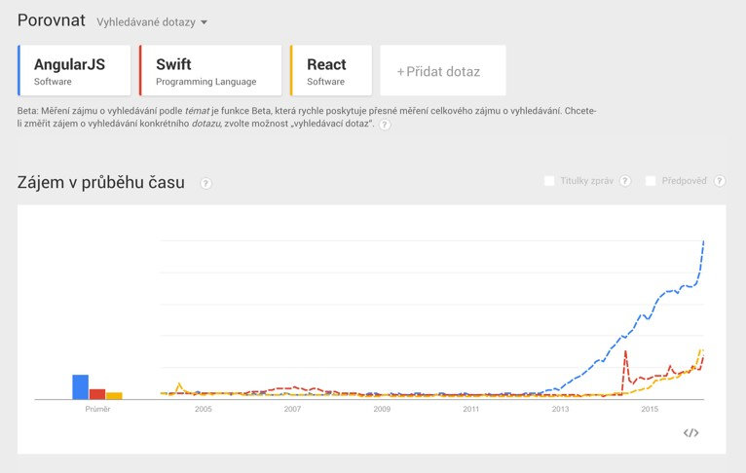
I S A N G U L A R D E A D ?
Source: http://google.cz/trends/explore

Slide 52

A N G U L A R 2
In BETA!

Slide 53

I O N I C 2
For Angular 2 in beta version

Slide 54

K I L L E R F E AT U R E S
Automatic platform customizations
Pre-defined UI components from Android, iOS
Ionic CLI and services (Deploy, View, Push, Creator,…)

Slide 55

S Y N TA C T I C A L LY A W E S O M E C S S
SASS/SCSS
Easily to customize/override
Stand-alone SCSS

Slide 56


Slide 57

700+ ICONS INCLUDED
I O N I C O N S
http://ionicons.com

Slide 58
D E M O

Slide 59
H O M E W O R K
Install Android SDK and NodeJS
http://bit.ly/1W38RfK
http://zdrojak.cz/clanky/vyvijime-hybridni-aplikace-v-ionicu
http://bit.ly/1Tt3tDF

Slide 60
Q U E S T I O N S ?

